Slide 1

Cdr Vijay Pratap Singh
Adjunct Professor, E&TC
TCET

Slide 2
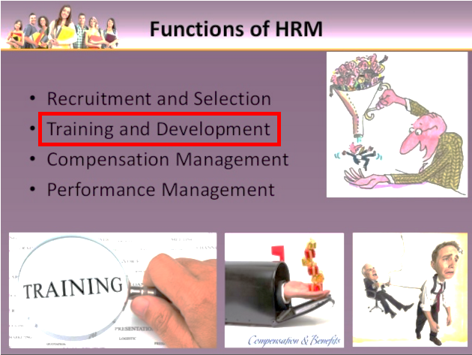

Slide 3
Training
“Training is expensive. Without training it is more expensive”

Slide 4

What is Training?

Slide 5
What is Training ?
Training is the formal and systematic modification of behavior through learning which occurs as a result of education, instruction, development and planned experience.
Training is the act of increasing the knowledge and skills of an employee for doing a particular job and development involves the growth of employees in all respect.
Training helps the employee in learning job skills whereas development shapes attitude of the employee.

Slide 6
Meaning of Training contd.
Training is an organized activity for increasing the technical skills of the employee to enable them to do particular jobs efficiently.
Training is equally important for the existing as well as new employees.
It enables the new employee to get acquainted with their jobs and also increase the job-related knowledge and skills
It’s a short term process

Slide 7

NEED FOR TRAINING

Slide 8
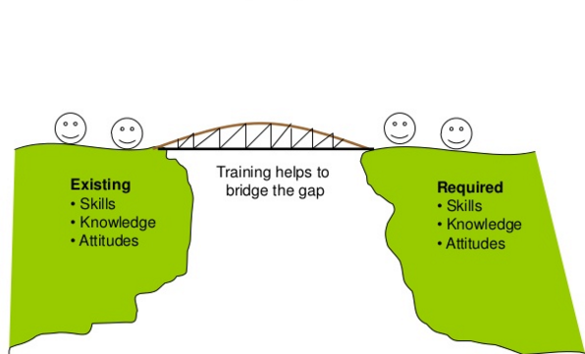
Training ?

Slide 9
Why T&D ?
Training :
Helps the employees to do their current jobs.
Development :
Helps the individual to handle future responsibilities

Slide 10
Need for Training
Higher Productivity
Quality Improvement
Reduction of learning time
Industrial Safety
Reduction of Turnover and absenteeism
Technology Update
Efficient Management

Slide 11

TRAINING OBJECTIVES

Slide 12
Objectives of Training
To provide job related knowledge to the workers
To bring about change in the attitude of workers towards fellow workers, supervisor and the Organization
To Improve the productivity of the workers and the organization
To Prepare workers for promotion to higher jobs by imparting them advanced skills.
To make the workers handle materials, machines and equipment efficiently and thus to check wastage of time and resources.

Slide 13

TRAINING BENEFITS

Slide 14
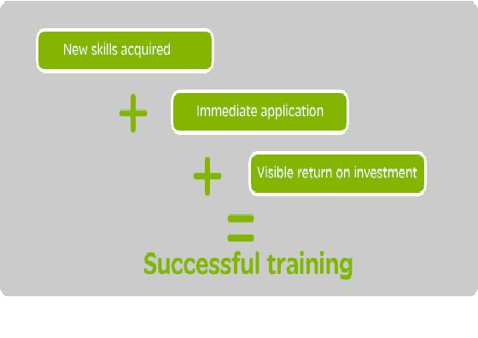
Benefit Of Training

Slide 15
Benefit of Training to the Organization
Economy in operations
Greater Productivity
Increases Profitability
Uniformity of Procedures
Systematic Imparting of skills
Creation of Inventory of skills
Less Supervision
Higher Morale
Develops Organization culture & Climate

Slide 16
Benefit of Training to the Workers
Acquisition of New Skills
Higher Wages
Industrial Safety
Preparation for Promotion
Versatile Utility
Higher Morale

Slide 17
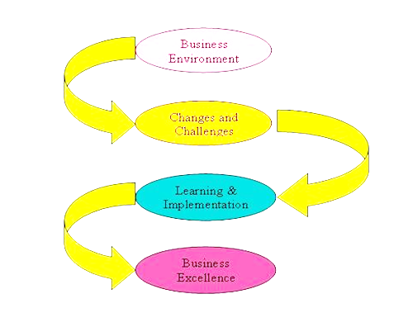
Importance Of T&D

Slide 18

Training In Corporate

Slide 19
TRAINING @ TCS
In TCS there is ILP, the Initial learning programme for 23 days at their main 6 training centers that is Induction.
There is exams in between and their performance will affect their salary.
Tata Consultancy Services launched its science-to software training program in the Chennai.
Thereafter the trainees will be absorbed into any of the company’s services depending on their Performance

Slide 20
TRAINING @ INFOSYS
In Infosys the recruits are divided into computer background and non computer background.
Training is in their Mysore campus and it is of 16 weeks.
At the end of training they have comprehensive exams and their performance will affect their salary

Slide 21
TRAINING @ WIPRO
In WIPRO the training is 3 step
First month is the fundamental readiness program
Second month is project readiness program
3rd month is real time lab, where they need to do a project

Slide 22

Training Models

Slide 23
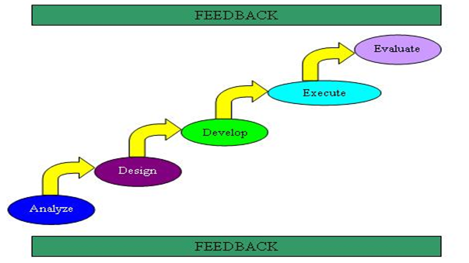
System Model Training

Slide 24
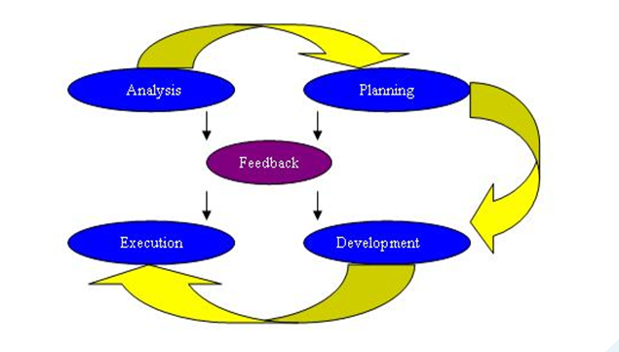
Instructional System Development Model (Isd) Model

Slide 25

Training Vs Development

Slide 26
Training Vs Development
BASIS FOR COMPARISON | TRAINING | DEVELOPMENT
Meaning | Training is a learning process in which employees get an opportunity to develop skill, competency and knowledge as per the job requirement. | Development is an educational process in which the personnel of the organization get the chance to learn the in depth application of theoretical knowledge for their overall growth.
Term | Short Term | Long Term
Focus on | Present | Future

Slide 27
Training Vs Development
BASIS FOR COMPARISON | TRAINING | DEVELOPMENT
Concentrated towards | Job | Career
Instructor | Trainer | Self
Objective | To improve the work performances of the employees. | To prepare employees for future challenges.
Number of Individuals | Many | Only one
Aim | Specific job related | Conceptual and general knowledge

Slide 28

Emerging Trends

Slide 29
Emerging trends IN TRAINING And DEVELOPMENT
Computer assisted training
Computer based training
Active Learning
Roles as a Trainer
Influence of e-Learning
Adaptive Learning
Integrating learning and development into organisational strategy
Behavioural Changes

Slide 30
Emerging trends IN TRAINING And DEVELOPMENT
Real use of training experts
Trainees’ Motivation and Timely Counseling for better result
Competency Mapping
Comfort level Training
Social Networking
Create own learning devices

Slide 31
Emerging trends IN TRAINING And DEVELOPMENT
Demand for Mobile-Learning
Technology based methods:
Creation of cloud based platforms
Performance Consulting
Gamification techniques for training
Organisations are becoming more transparent

Slide 32

Training methods

Slide 33
TRAINING METHOD
A large variety of techniques are used in every business. Even within one organization different methods are used for training different people.
All the methods are divided into two categories:
ON THE JOB TRAINING METHODS
OFF THE JOB TRAINING METHODS

Slide 34
ON THE JOB TRAINING
Under these method, new and inexperienced employees learn through observing peers or managers performing the job and trying to imitate their behavior.
Employees learn in the real work environment and gain experience dealing with the tasks and challenges that they will meet during a normal working day. training is given on the same machines and experience would be on already approved standards, and above all the trainee is learning while earning.

Slide 35
ON THE JOB TRAINING METHOD
1) COACHING
One to one training (an experience staff to trainee)
Quickly identifies the weak areas and tries to focus on them
Theory to practical
In India, most of the scooter mechanics are trained only through this method

Slide 36
ON THE JOB TRAINING METHOD
2)MENTORING
Each trainee is allocated to an established member of staff who acts as a guide and helper
Focus is to develop personal attitude
A mentor usually offers more personal support than a coach
One to one interaction, like coaching

Slide 37
ON THE JOB TRAINING METHOD
3)JOB ROTATION
Members of staff rotate roles or tasks so that they gain experience of a full range of jobs.
Rotation not only makes a person well acquainted with different job, but it also reduce or alleviates boredom and develop harmonious relationship with a number of people

Slide 38
ON THE JOB TRAINING METHOD
4) JOB INSTRUCTIONAL TECHNIQUE
Step by step (structured) on the job training method where:
a)Trainer prepare trainee with an overview of the job, its purpose and the result desired,
b)Demonstrate the task and skill to the trainee
c)Allow the trainees to demonstrate themselves
d)Follows up to provide feedback and help
e)Learning material in written or learning machines through a series called ‘frames’
Valuable for educators as it help:
To deliver step by step instruction
To know when the learner has learned
To be more conscientiousness in the working environment

Slide 39
ON THE JOB TRAINING METHOD
5)APPRENTICESHIP
Direct learning from the experts or under the direct supervision of their master for long period or a specific period of time
Serve as an apprentices and the objective is make the trainee all round skilled men
Expensive and no guarantee from the trainee as to serve the organization that he was trained
Paid remuneration according to the apprentice agreement.

Slide 40
ON THE JOB TRAINING METHOD
6)UNDERSTUDY
Superior gives training to subordinate as his/her understudy like an assistant to a manager or director (in a film)
Subordinate learn through observation and experience by participating in handling day to day problems.

Slide 41
ADVANTAGES OF ON THE JOB TRAINING
Generally most cost-effective
Employees are actually productive
Opportunity to learn while doing
Training alongside real colleagues
DISADVANTAGES OF ON THE JOB TRAINING
Quality depends on ability of trainer and time available
Bad habits might be passed on
Learning environment may not be conducive
Potential disruption to production

Slide 42
OFF THE JOB TRAINING
Provided away from the immediate workplace or is conducted separate from the job environment
study material is supplied
There is full concentration on learning rather than performing, and there is freedom of expression
This might be at a specialist training Centre or at a college or at a company’s own premises.
This type of training can be particularly useful for developing transferable skills that can be used in many different parts of the business.
It may be used for example, to train employees in the use of new equipment and new methods or to bring them up to date with changes in the law.

Slide 43
OFF THE JOB TRAINING METHOD
1)LECTURE AND CONFERENCES
Traditional and direct method of instruction
Every training programme starts with lecture and training, verbal presentation for large audience
Lecture have to be motivating and creating interest among the trainees
The speaker must have considerable depth in the subject
In the colleges and universities, lectures and seminars are the most common methods used for training.

Slide 44
OFF THE JOB TRAINING METHOD
2)VESTIBULE TRAINING
The workers are trained in a prototype environment on specific jobs in a special part of the plant.
After training, the workers may be put on a similar jobs in the actual work shop
During the Second World War II, this method was used to train a large number of workers in a short period of time.
It prevents trainees to commit costly mistakes on the actual machines.

Slide 45
OFF THE JOB TRAINING METHOD
3) SIMULATION EXERCISES
Simulation is any artificial environment exactly similar to the actual situation.
four basic simulation techniques used for imparting training: management games, case study, role playing, and in-basket training.
i)Management games:
Helps candidate practical applicability of the subject.
Help to ingrain thinking habits, analytical, logical and reasoning capabilities, importance of team work, time management, to make decisions lacking complete information, communication and leadership capabilities.

Slide 46
ii)Case study:
Bridging the gap between theory and practice by allowing the application of theoretical concepts to be demonstrated
Encourage active learning, provides an opportunity for the development of key skills such as communication, group working and problem solving, and increases the trainees” enjoyment of the topic and hence their desire to learn.

Slide 47
iii)Role playing:
The steps involved in role playing include defining objectives, choose context & roles, introducing the exercise, trainee preparation/research, the role-play, concluding discussion, and assessment.
Each trainee takes the role of a person affected by an issue and studies the impacts of the issues on human life and/or the effects of human activities on the world around us from the perspective of that person.
It help student to deal with complex problems with no single “right” answer and to use a variety of skills beyond those employed in a typical research project.

Slide 48
OFF THE JOB TRAINING METHOD
4)SENSITIVITY TRAINING
Also known as laboratory or T-group training
About making people understand about themselves and others reasonably, which is done by developing in them social sensitivity and behavioral flexibility
It reveals information about his or her own personal qualities, concerns, emotional issues, and things that he or she has in common with other members of the group
It comprises of three steps:
1.Unfreezing the old value
2.Development of new value
3.Refreezing the new one

Slide 49
OFF THE JOB TRAINING METHOD
5)TRANSACTIONAL ANALYSIS
It provides trainees with a realistic and useful method for analyzing and understanding the behavior of others. In every social interaction, there is a motivation provided by one person and a reaction to that motivation given by another person.
This motivation reaction relationship between two persons is known as a transaction. Transactional analysis can be done by the ego (system of feelings accompanied by a related set of behaviors states of an individual).

Slide 50
There are three type of ego state
a)Child:
It is a collection of recordings in the brain of an individual of behaviors, attitudes, and impulses which come to him/her naturally from his/her own understanding as a child. The characteristics of this ego are to be spontaneous, intense, unconfident, reliant, probing, anxious, etc. Verbal clues that a person is operating from its child state are the use of words like “I guess”, “I suppose”, etc. and non verbal clues like, giggling, coyness, silent, attention seeking etc.

Slide 51
b)Parent:
It is a collection of recordings in the brain of an individual of behaviors, attitudes, and impulses imposed on her in her childhood from various sources such as, social, parents, friends, etc.
The characteristics of this ego are to be overprotective, isolated, rigid, bossy, etc. Verbal clues that a person is operating from its parent states are the use of words like, always, should, never, etc. and non-verbal clues such as, raising eyebrows, pointing an accusing finger at somebody, etc.

Slide 52
c)Adult:
It is a collection of reality testing, rational behavior, decision making, etc. A person in this ego state verifies, updates the reaction which she has received from the other two states. It is a shift from the taught and felt concepts to tested concepts.

Slide 53
Simulation Exercise Method
Simulators are a group of training devices of varying degrees of complexity that model the real world.
They range from simple paper mock-ups of mechanical devices to computerized creations of total environments.
In fact, some argue that case-study, role-play and a host of other methods can be brought under the category of simulation.
The advantage of simulation methods is that they improve the possibility of learning without damaging the equipments or human life or facing the numerous risks involved in actual performance.
For example, most of traffic rules, signals and procedures of driving could be taught in a park that resembles main road or through a video game featuring car or two wheeler driving. Piloting planes are taught using more complex simulations.
The methods are indirect but could also be expensive. The method calls for a certain level of grasp and information processing capability and transfer of learning on the part of the trainees.

Slide 54
Role-Play Method
Role is a set of expectations around a given position and is determined by the role partners.
Roles are always reciprocal and described in pairs such as trainer-trainee, buyer-seller, interviewer-interviewee and so on.
Playing roles would entail practical problems like inter-role conflicts, intra-role dilemmas, role overloads and role under loads. As a result of these hurdles, role confusion ensues. In order to be trained to perform roles, trainees must attain role clarity.
This may involve negotiation among the role senders and role receivers with regard to their expectations with counter expectations upon one another. Participants in role-play method are required to respond to specific problems and expectations of people that they might actually encounter in their jobs.
Role-playing is often used to teach such skills as interviewing, negotiating, grievance handling, performance appraisal, and buying and selling and effective communication. It promotes healthy human relations skills among people.

Slide 55
Case study Method
It is a written down, narrative description of a real situation or incident relating to an organization and its business, depicting any problem that participants could face in their employment.
Participant trainees are required to propose any number of viable solutions or decisions that match the variables represented in the case. Case study can be interest creating and thought stimulating for the participants.
It helps to develop analytical, reasoning and problem-solving skills of the participants. As it shows and reduces gaps in understanding, a holistic understanding of reality is made possible through case study method. It also helps to reemphasize messages provided during lectures, group discussions and other methods.
The disadvantage of the method might be the difficulty in drawing adequate number of stimulating cases that actually represent the real life situations of the trainees.

Slide 56
Management Games Method
Games are used as a training tool, than as mere pastimes or amusement. Trainees are divided into teams and are given common tasks on which they would be competing to arrive at decisions, and then jointly implementing and evaluating the decisions taken with regard to the games.
For example, blocks of wood would be supplied to every team and one of the members would be blind-folded with a piece of cloth. The person would have to arrange the blocks one above the other, as per the instructions and guidance of the other members.
As they set on to reach greater target heights, the rewards would also grow exponentially. This game is used to bring out the nuances of teamwork, leadership styles and communication patterns exhibited by the members while playing the game.
The demerits of the method are that, at times, games might result in lack of seriousness in some trainees and that the learning is indirect and slow. But it helps to convey messages in a non-threatening and fun-filled manner.

Slide 57
Outward Bound Training (OBT) Method
As part of OBT, managers and other staff members meet and cohabitate as teams at unfamiliar wilderness out of the workplace and away from the hustles and bustles of daily life, where they would live in cabins or tents for a certain number of days.
They test their survival skills and learn about their own personality and hidden potentials for creativity, cooperation and leadership.
Participants get opportunities to learn their limits and capabilities. Participants irrespective of their official position and seniority would have to learn to be natural in their behaviour and get rid of masks worn in an office situation.
It is an expensive method and the learning might not be transferable to others or to other situations.

Slide 58
Vestibule Training Method
This kind of training takes place away from the production area on equipment that closely resembles the actual ones used on the job.
It is a type of off-the-job training in which employees get training in a realistic job setting but in a location different from the one in which they would be working.
For example, a group of lathes may be located in a training centre where the trainees will be instructed in their use.
The method is used frequently for training typists and bank tellers, among others. The word ‘vestibule’ means entrance. Thus vestibule training serves to facilitate full-fledged entry into job.
A primary advantage of vestibule training is that it removes the employee from the pressure of having to produce while learning. Disturbance of production or supervisor during training is minimized. The disadvantages include the extra investment on equipment and additional persons to be employed as trainers.

Slide 59
Apprenticeship Training Method
It combines classroom instructions with on-the-job training. It is a method in which trainees at a novice stage called ‘apprentices’, work under the guidance of skilled, licensed instructor and receive lower pay than workers.
The method is a combination of education and employment and is aimed at preparing workforce with certain levels of qualification to meet the growing needs of the industry.
The method develops special skills like mechanical, electronic, tailoring, etc. Apprenticeship is traditionally used in skilled jobs, such as those of plumber, carpenter, machinist and printer. The extensive nature of the training assures quality outputs, though time consumed is long.
Employees recruited from the apprenticeship program are expected to hit the ground running, implying that they would have to start performing with efficiency. But uniform duration of apprenticeship training does not permit slow learners to reach the levels of mastery like others.

Slide 60
Personal Coaching Method
It is an on-the-job approach in which a manager has the opportunity to teach an employee, usually his immediate subordinate, on a one-to-one basis.
Coaching is helping self and others gain new perspectives their intentions and behaviours, to understand what’s possible and how to access inner resources such as motivation, commitment, passion, etc. as a coach, the supervisor gently confronts employees with their shortcomings and makes suggestions for corrective actions.
The supervisor is also alert to encouraging good performance. Coaching is considered to be one of the most effective management development techniques. Constant guidance makes the trainee learn quickly.

Slide 61
Mentoring Method
Mentoring is an on-the-job approach to training in which the trainee is given an opportunity to learn on a one-to-one basis from more experienced members of the organization.
The mentor is usually an older, experienced executive who serves as a host, friend, confidant and advisor to a new member of the firm. The mentor is given the charge of protecting and responsibility of helping the new employee.
The relationship may be formally planned or it may develop informally. For mentoring to be productive, the parties’ interests must be compatible and they must understand each other’s learning styles and personalities.
If mentors form overly strong bonds with trainees, unwarranted favouritism might result. A highly successful mentor-protégé relationship might create feelings of jealousy among other colleagues who are not able to show equally good results out of the mentoring process.

Slide 62
Job Rotation Method
This method of training involves the shifting of trainees from one job to another so as to widen their exposure and enable them to obtain a general understanding of the totality of the organization.
Besides helping them to overcome boredom, job rotation permits direct interaction with a large number of individuals within the organization, thereby facilitating future working relationships. The method should be used at sufficient gaps to permit the development of a strong degree of expertise in the trainee in an assigned position.
Care should be taken by the organization to ensure that work efficiency does not suffer when a few trainees are rotate into new jobs where they would be taking time to learn and perform. There could be some disadvantages of using the method of Job Rotation.
Trainees have to be prepared to face contrasting styles of operation and standards that vary according to superiors. Some trainees might feel more like visiting casual observers in the departments than being a part of the workforce, which would negate the purpose of job rotation. Employees who are looking for more challenging assignments might feel frustrated when asked to perform different kinds of simple jobs at the same level.

Slide 63
Computer-Based Training (CBT) Method
CBT is a technology-driven training method that takes full advantage of the speed, memory and data manipulation capabilities of the computer for greater flexibility of instruction. It involves the trainee sitting in front of a computer terminal rather than listening to an instructor.
Learning is enhanced through presentations combining automation, stereophonic sound, full motion video and graphics. Increased speed and decreased dependence on instructor are the strengths of this method. Computer-Managed Instructions (CMI) is a system that automatically generates and scores tests, tracks trainees’ performance and prescribes activities for students.
An orderly, step-by-step manner is possible by using this method. As additional advantages, CBT allows reuse of the program for any number of time and allows for varying time for fast and slow learners.
But CBT method cannot reduce the learner’s anxiety and fear, which can be done only by a trained instructor. CBT is well suited for teaching facts but is less useful for teaching human skills or changing attitudes.

Slide 64
Internship Method
Internships involve placing young college and university students in temporary jobs in which they can earn while they learn, with no obligations towards any regular employment from the side of the employer or from the trainee.
Such an arrangement enables to provide a fresher the much-needed exposure to an organization and also to determine the person organization fit.
Students divide their attention between academic activities and practical work assignments, which help them to internalize the theory and practices.
However, care must be taken to prevent the whole process from getting reduced to the fulfilment of merely an academic requirement rather than being treated as a stepping-stone towards an illustrious career.

Slide 65
Classroom Lecture Method
Most commonly used, simple, cost effective and conventional method.
Timesaving because it covers maximum number of people in a short period of time.
It involves a speech by the instructor with very limited discussions.
Clear and direct methods of presentation.
Weaknesses- lecture time is more than the normal human attention span of fifteen minutes and the contents of the lecture could be easily forgotten.
Since the method does not provide for active participation on the part of the trainees, the extent of take-home learning is not to be known clearly.
Moreover, lecture might be useful only if the presentation is made skillfully. While lecture is a useful method in so far as information dissemination is the objective, it has not been highly successful in modifying human behavior or in building commitments in the audience’s minds. An improvisation of this method is the lecture-cum-demonstration method in which the lecturer reemphasizes a skill or information by displaying the same in action.

Slide 66

Group Discussion Method
Used to knowledge and attitudinal development of trainees.
Sets of people examine several empirical studies to find out commonalities to derive the underlying general principles.
They then combine their ideas and focus their attention on a given problem at a time, speaking from multiple points of view within a group.
An instructor is optional, while a leader is necessary in this method.
The various advantages of the method are that more ideas can be generated from each session.
Moreover each member gets an opportunity to present one’s own ideas and get feedback from members of the same group.
Peer pressure and commitments made to groups serve to ensure adherence to decisions jointly taken in the group. As a precaution, care must be taken to secure the participation of all members and make sure that a few members do not pre-determine the course of discussions or dominate the whole proceedings.

Slide 67

Case Study : Training AND DEVELOPMENT at infosys

Slide 69
ADVANTAGES OF OFF THE JOB TRAINING
A wider range of skills or qualifications can be obtained
Can learn from outside specialists or experts
Employees can be more confident when starting job
DISADVANTAGES OF OFF THE JOB TRAINING
More expensive – e.g. transport and accommodation
Lost working time and potential output from employee
New employees may still need some induction training
Employees now have new skills/qualifications and may leave for better jobs

Slide 70

Development

Slide 71
Development v/s Training
For the most part, the terms "training" and "development" are used together to describe the overall improvement and education of an organization's employees.
However, while closely related, there are important differences between the terms that center around the scope of the application.
In general, training programs have very specific and quantifiable goals, like operating a particular piece of machinery, understanding a specific process, or performing certain procedures with great precision.
Developmental programs, on the other hand, concentrate on broader skills that are applicable to a wider variety of situations, such as decision making, leadership skills, and goal setting.

Slide 72
Development
As the word suggests, it is progress i.e. a growth or success over a period of time.
For a business, it can be expansion and diversification and for an individual may be a promotion or a salary hike

Slide 73
Why is it needed?
If you think training is expensive, try
IGNORENCE !!

Slide 74
Why is it needed?
It is acknowledged as one of the determinants for organizational success having a direct impact on its economical benefits.
For organizations, making available such techniques to their managers helps the company to hold on to their prized employees.
It also helps the organization to serve their customers better.
The productivity of the managers as well as employees increases.
Leadership and risk taking ability of the manager is enhanced, making the overall working environment of an organization, challenging.
It helps in exploring skills of a manager and the employees which were till now not active or unresponsive.

Slide 75
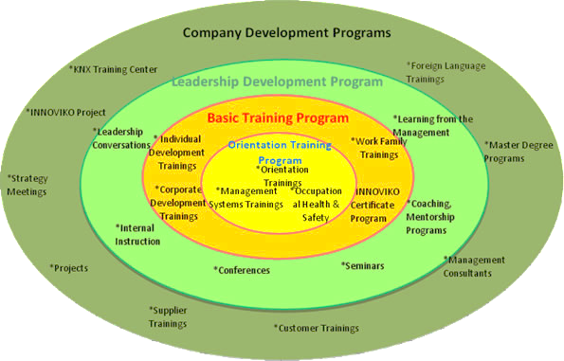

Slide 76
A Need to establish or update development objectives
Conduct Self Assessment: Interests, Values, Likes & dislikes
Gather input fro Peers and management on strengths & Weaknesses.
Review current job performance.
Have you been in your current position long enough to make a significant contribution?
Do you want or should you consider other job opportunities?
Research other positions in the organization and determine required skills, aptitudes and knowledge.
YES
YES
NO
NO
Understand long term (1-3 years) direction of business, organization, function, or project.
Determine how you current job may change in the future and what new skills, abilities, and aptitudes will be needed.
Write development plan

Slide 77
Write development plan.
Employee and supervisor finalize development plan.
Pursue development opportunities.
Review progress.
If necessary, make adjustment to the plan.
Objective met?
NO
YES
Individual or organizational success!
Establish a new
development plan.

Slide 78

Development Methods

Slide 79
Sensitivity Training or T Group Training or Laboratory training Method
It is a set of experiences in unstructured agenda-less groups designed to make people aware of themselves (self-insight), their immediate situation and their own impact on others.
Unlike many other programs, T-groups are concerned with the real problems existing within the group itself.
People are helped to become more responsive to others’ sensitivities and work more harmoniously and responsibly together by encouraging them to interact freely and actively.
The members are enabled to recognize group dynamics and diagnose human relationship problems. The participants are encouraged to communicate thoughts and feelings with each other in an open, unstructured, warm and honest manner than is typically done in the usual work or social situation.
A beneficial outcome of the method is that participants find better means of behaviour for effective interpersonal relationships without the aid of power or authority over others. The method has to be used carefully as people may resent negative feedback and show anger in response. People have to be first prepared well to accept criticism in a constructive manner so that conflicts could be managed properly.

Slide 80
In-Basket Training(IBT) Method
IBT is a method where the trainee is required to examine a basket full of papers and files relating to his area of work and make recommendations on problems contained in them.
This method is meant for trainees in a managerial level to improve their decision-making and problem-solving abilities.
This is a form of simulation training designed around day to- day business situations and hence is transferable to the job experiences.
The participant is usually asked to establish priorities for and then handle a number of office papers, such as memoranda, reports, telephone messages and emails that would typically cross a manager’s desk.
The method has at least two main stages. At the outset, the participant starts by working through the case within a specified time limit all by himself without discussing the details with anyone. Subsequently, other participants analyse and discuss the questions of who’s, which’s, how’s, what’s, where’s, why’s and when’s of each decision or step. The merits of this method include the best of traditional case study at the same time combining the refinements to allow greater flexibility, realism and involvement.
The emphasis here is to understand things thoroughly, which is an opportunity too rarely presented during busy working days. It is done in a permissive atmosphere of experimenting and learning, rather than within the confines of a boss subordinate relationship.

Slide 81
Work Shadowing Method
This training method is chosen while preparing a second-line leader to take up the role of the headship, in which case, the candidate could not benefit by sending them to any other formal training program.
The best way to be trained for a future executive position would be through direct participant observation of the crucial events that take place in the present incumbent’s work life.
The trainees are made to remain in the company of the role model whose work is to be learnt by the trainees.
Trainees learn the intricacies of a job of high level, by physically being in the presence of the job-holder. Closely following the styles of working permits greater degree of learning besides helping the trainee to imbibe the values and principles adhered to by the model.
Yet, care needs to be taken to avoid situations wherein trainees are not warmly welcomed and are seen by supervisors in the department as obstacles to their routines.

Slide 82
Programmed Instruction Method (PIM)
PIM provides instruction without the face-to-face intervention of an instructor.
To ensure a sequential approach to learning, instructions are designed in such a way that all future learning depends on acquisition and retention of previous learning.
With this method, information is broken down into small portions called ‘frames’. The learner reads each frame in sequence and responds to questions designed to verify learning.
Based on the answers given by the trainees they are provided with immediate feedback on response accuracy. If the learners have got all the answers right, they proceed to the next frame. If not they repeat the frame.
Primary features of this approach are immediate reinforcement and the ability of learners to proceed at their own pace. Programmed instructions may be presented in a book or in computers.

Slide 83
Large Scale Interactive Events (LSIE) Method
The method has a lot of unique advantages when compared to other methods.
First, this method stresses upon the sharing of expertise by all the participants, unlike other methods where the instructor supplies most of the inputs and might even look down upon trainees as people who are ignorant or unskilled in the topic being covered.
LSIE is based on the belief that all the participants, by virtue of being in their job for a certain period of time, possess some degree of expertise that need to be shared and combined with that of others.
Second advantage is that this method transcends the limitation of other methods in terms of the number of people who could be trained per batch. The major advantage of this method is that a group as large as 300 – 400 members could be trained simultaneously without losing the effectiveness of other training methods. The third advantage is the use of group processes. While the trainer limits his role with a brief but inspiring presentation to stimulate thinking of the participant, the methods paves way for active involvement of all the participants who are assigned various roles such as sub-group leader, recorder, summarizer, presenter etc. A fourth advantage of the LSIE is that the group emphasizes on extensive on-the-spot documentation of viewpoints expressed by people. Finally, the method culminates in the entire large group addressing to the common issues. At this stage, priority is to be set on areas of intervention and a plan of action is drawn and accepted based on voting by members, thereby building commitment of all the participants to implement the agreed upon plans. A disadvantage of the method could be that it requires a lot of volunteers to assist the proceedings.

Slide 84
Behaviour Modelling Method
This method involves emulation of behaviour from a reference group or a role model whose behaviour is shown live before the trainees or by using videotapes or Compact discs (VCD).
The method entails recording and producing events or situations with clear descriptions in order to cover certain subjects. The footage could be viewed, reviewed and discussed to enhance learning quality.
The advantages of using this method are many. Many events and discussions can be put on one tape or CD. It is a handy method for small firms that cannot afford more expensive approaches. It is particularly helpful for first-line supervisors.
Observing a powerful model in the audio-visual form could help learn activities like mediating during conflict situations, handling customer complaints and grievances. The challenges involved in using the method include the high level of one-time production costs in the initial stage. Moreover, projectors and other expensive gadgets would be required along with continuous power supply.

Slide 85
Development Centre Method
This method is designed based on the structure, styles and contents of assessment centres used to assess the potential of an individual to meet the demands of a higher-level managerial position.
Multiple facilitators observe the members performing multiple tasks according to multiple criteria, using multiple methods.
However, the difference in development centres is that they focus their attention on helping to improve the potential of the persons participating in the sessions.
This method of training is found effective in building leadership, decision-making, goal setting and counselling skills in experienced trainees.

Slide 86
Demerits of Development methods
The chief demerits of the coaching methods are as follows:
The trainer may impose upon the trainees his work habits, ideas, beliefs, and methods of doing the work. Coaching method, therefore, has a tendency to perpetuate the current management styles and practices rather than promoting innovative styles.
The effectiveness of coaching methods depends on the ability of the trainer. If the trainer is inexperienced, possesses pseudo-knowledge, and follows dogmatic principles, there would not be any use of coaching the trainee executives.
Coaching method would be effective if the superior has extraordinary communicative skills, and if he provides a common platform for exchanging the ideas with the trainee executives without becoming too comment, and if he has the capacity to stimulate the executives to learn and practice the work

Slide 87
Demerits of understudy method:
If a wrong person is selected as ‘understudy’ (due to favoritism or any other factor) there are opportunities for sizable errors which may turn out to be costly to the entire organization.
The understudy may be picked up by the superior and in this process the may exhibit favoritism; this may promote the tendencies of sycophancy and perpetuation of the existing practices of in-breeding.

Slide 88
Job rotation suffers from the following defects:
Job rotation may result in over-centralization; inflexibility and inefficiency.
Job rotation has the disadvantages of a ‘musical chairs game’ because it leaves behind some executives who are not at all rotated and some are constantly rotated either by virtue of their cleanness to their bosses or by their intelligence. This may lead to class-struggles between the executives who are rotated and those who are not.
Job rotation may involve frequent transfers which may upset the executive’s organizational, family, and home life.
Job rotation may also result in certain dysfunctional behaviors in terms of jealousy, cleavage, non-cooperation, friction within the departments, etc.
To make job rotation effective, executives who are rotated or. different jobs should be educated to view the change as an opportunity for genuine learning and experience.

Slide 89
The chief disadvantages of the in-basket method are:
The in-basket method may discourage original ideas because the ideas of an executive may be turned down by the group a whole.
The solutions prescribed by the group of executives may not be accepted by the top management and hence the entire exercise may become redundant and unnecessary.

Slide 90
Few Surprising Employee Development Statistics
As one of the top three non-financial motivators, 76% of employees want opportunities as career growth.
Many studies have found that certain non-financial motivators can be just as effective, if not more, than monetary rewards. Employees are looking for learning and development offerings that will help them on their professional journey in the long run.
25% of employees would be more satisfied at work if they were given the opportunity to do what they do best.

Slide 91
Few Surprising Employee Development Statistics [cont…]
The thing that many managers seem to instantly forget once they get that corner office is that employees want to be good at what they do, they want to succeed in their position. The problem is usually that they aren’t given the tools or opportunities to do so. Learning, development and training are all great ways to help employees reach their full potential.
Training and development spend has risen by 15% in the last year alone.
In fact, training spend has risen by about 25% since the tail end of the recent economic recession. That is a pretty serious trend in corporate spending, especially when you consider that training is known as one of the most discretionary spends in business. Employers are beginning to search for innovative ways to attract quality talent, bridge the skill gap and give employees a reason to stay –employee development is it.

Slide 92
Few Surprising Employee Development Statistics [cont…]
Research tells us that over 70% of learning on the job occurs informally. Tweet that stat.
We think that’s great! We also think informal learning needs a formal edge to ensure that processes and practices remain aligned with organizational goals. Simple practices that don’t inhibit learning, but guide it, like 360 reviews, a great talent management program and total performance transparency.
40% of employees who receive poor job training leave their positions within the first year.
These employees cited lack of skills training and development as the main reasons they chose to voluntarily leave their positions. Put simply, training and development efforts are seen by employees as an investment in them. It’s a “no-duh” in leadership that rewards and recognition are powerful motivators, but it’s a lesser-known fact that employee development is in high demand as a motivator.

Slide 93
Company Profile
Infosys Limited formally Infosys Technologies is an Indian global technology services company headquartered in Bangalore.
Infosys is ranked 27 in the list of top companies of India in Fortune India 500 list in 2011. It has offices in 29 countries and development centers in many countries.
Infosys had 145,088 employees of 85 nationalities as on December 31, 2011.
Infosys provides business consulting, technology, engineering and outsourcing services to help clients in over 30 countries.

Slide 94
Training and Development initiatives are available at each milestone and cover the following-
Technical training by Education & Research department: Entry-level technical training program, which is for a duration of 14 weeks. This program has been certified by educationists as being equivalent to a BS program in the US. The Education & Research (E&R) department at Infosys offers a variety of training programs on a regular basis for Middle level employees as well.

Slide 95
Quality Process Training: Infosys has a strong focus on quality processes and methodologies. This training is tailored to the role that one is playing ie. Software Engineer, Programr Analyst, Project Managers etc

Slide 97
Personal Effectiveness and Managerial Programs: Programs to enhance the managerial capabilities and leadership abilities, to enable better customer satisfaction, achieve organizational vision and create high performing multicultural teams.

Slide 99
ILI: The Infosys Leadership System:
The Infosys Leadership System (ILS) and the Infosys Leadership Institute (ILI) address the issue of sustained growth in general and creates a formal and committed system for developing leadership capabilities in Infoscions. The most significant attribute of the Infosys leadership development model is its partnership approach with the other groups in Infosys and the ownership of the entire process by the top management in what is termed as the ‘Internal Synergy Model’. ILI is based at a world-class physical infrastructure, in Mysore, India.

Slide 100
Technology
Performance Focus
Driving Change
Personal Effectiveness
Work
People
Business
Developing Leaders
Customer Partnering
Teamwork
Creating Positive Work Environment
Organizational Savvy
INFOSYS LEADERSHIP SYSTEM

Slide 101

INFRASTRUCTURE - Infosys
The education and research center housed in the company’s headquarters in Bangaluru can train 1000 software engineers simultaneously.
It comprises fully equipped classrooms, labs with video – conferencing units, individual faculty rooms and a 30,000 square foot library with a capacity of 10,000 books.

Slide 102
Result and Effect
Golden Peacock National Training Award (GPNTA)
Year-2009
Category-Employer
For-Training Design
Year- 2006
For- IT Sector
Reduction in HR turnover

Slide 103


